Slide 1
Data Structure
CSE-207
Md. Manowarul Islam
Dept. of CSE, Jagannath University

Slide 2
Tree
A nonlinear data structure
Contain a distinguished node R, called the root of tree and a set of subtrees.
Two nodes n1 and n2 are called siblings if they have the same parent node.
Root
Subtrees

Slide 3
Binary Tree
A binary tree T is defined as a finite set of elements, called nodes such that:
  T is empty
  T contains a distinguished node R, called the root of T and the remaining nodes of T form an ordered pair of disjoint binary trees T1 and T2.
  T1 and T2 are called the left and right subtrees of R.
Any node N in a binary tree T has either 0, 1 or 2 successors.
Nodes with no successors are called terminal nodes or leaf nodes.

Slide 4
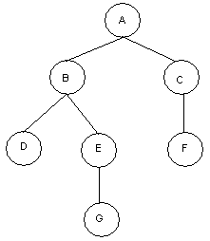
Binary Tree
Binary Tree: T
Root: A
Nodes with 2 Successors: A, B
Nodes with 1 Successors: C, E
Terminal Nodes: D, F, G

Slide 5


Binary Tree
Similar binary tree
  Two binary trees are similar if they have the same structure or same shape.
Copy Binary Trees
  Two binary trees are copies if they are similar and they have the same contents at the corresponding nodes.
T1 =
T2 =
T1 =
T2 =
T3 =
Figure: Similar T1 and T2.
Figure: Copy T1 and T3.

Slide 6
Binary Tree
Edge: A line from a node N of T to a successor is called is an edge.
Path: A sequence of consecutive edges is called a path.
Branch: A path from root node to a leaf node is called branch.
Level of Binary Tree: Each node in a binary tree T is assigned a level number. The root R of T has level number 0 and every other node has level number which is one more than the level number of its parent.
Depth of Binary Tree: Maximum number of nodes in a branch of T is the depth of T.

Slide 7
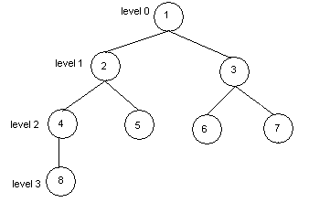
Binary Tree
Binary Tree: T
Edge: (1, 2), (3, 6) ....
Path: (1, 2, 4), (1, 3, 6)
Branch: (1, 2, 4, 8), (1, 2, 5), (1, 3, 6), (1, 3, 7)
Depth: 4

Slide 8
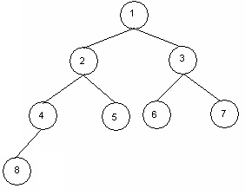
Complete Binary Trees
A binary tree T is said to be complete if
  all its level, except possibly the last, have the maximum number of possible nodes
  all the nodes at the last level appear as far left as possible.
  The depth D_{n} of the complete binary tree with n nodes

Slide 9
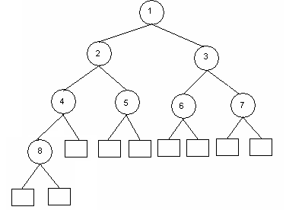
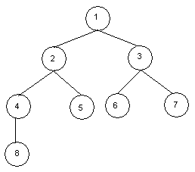
Extended Binary Tree (2-Tree)
A binary tree T is said to be an extended binary tree if
  each node N has either 0 or 2 children.
  Nodes with 2 children are called internal nodes.
  Nodes with 0 children are called external nodes.
  Internal nodes are represented by circles and external nodes by squares.
Binary Tree T1
Extended Binary Tree T2

Slide 10
Algebraic Expression as Binary Tree
An algebraic expression E can be represented by means of binary tree T
Example: ((c*d)+e)/(a-b)
/
+
-
*
e
a
b
c
d

Slide 11
Representing Binary Tree in Memory
Let T be a binary tree, then T can be represented in memory using two ways.
  1. Linked Representation
  2. Sequential Memory Representation/ Array representation

Slide 12
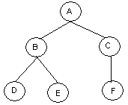
Linked Representation of Binary Tree
Use Three parallel arrays Info, Left and Right and a pointer variable Root.
  Info[K]: Contains data at node N.
  Left[K]: Contains location of left child of N
  Right[K]: Contains location of right child of N
  Root: Contains location of Root
Info
Left
Right
1
C
0
10
2
D
0
0
3
4
E
0
0
5
A
7
1
Root
6
7
B
2
4
8
9
10
F
0
0

Slide 13
Sequential Representation of Binary Tree
Use only a single liner array Tree.
  Tree[1] represents the Root of T.
  If node N is in Tree[K], then its left child is in Tree[2K]
  If node N is in Tree[K], then its right child is in Tree[2K+1].
1
2
3
4
5
6
7
8
9
10
Tree =
A
B
C
D
E
F

Slide 14
Sequential Representation of Binary Tree
If a tree has depth d then it will require a array of maximum 2^{d+1}.
  If T has depth 5
  then it requires an array of 2⁵⁺¹=64 elements
?=2³

Slide 15
Traversing a Binary Tree

Slide 16
Traversing Binary Tree
There are 3 ways of traversing a binary tree T having root R.
1. Preorder Traversing
Steps:
(a) Process the root R
(b) Traverse the left subtree of R in preorder.
(c) Traverse the right subtree of R in preorder.
Example:
A
B
C
Preorder Traversal of T
A, B, D, H, E, C, F, I, J, G
D
E
F
G
H
I
J
Figure: Binary Tree T

Slide 17
2. Inorder Traversing
Steps:
(a) Traverse the left subtree of R in inorder.
(b) Traverse the root R.
(c) Traverse the right subtree of R in inorder.
Example:
A
B
C
Inorder Traversal of T
D, H, B, E, A, I, F, J, C, G
D
E
F
G
H
I
J
Figure: Binary Tree T

Slide 18
3. Postorder Traversing
Steps:
(a) Traverse the left subtree of R in postorder.
(b) Traverse the right subtree of R in postorder.
(c) Traverse the root R.
Example:
A
B
C
Postorder Traversal of T
H, D, E, B, I, J, F, G, C, A
D
E
F
G
H
I
J
Figure: Binary Tree T

Slide 19
End

